Slide 1
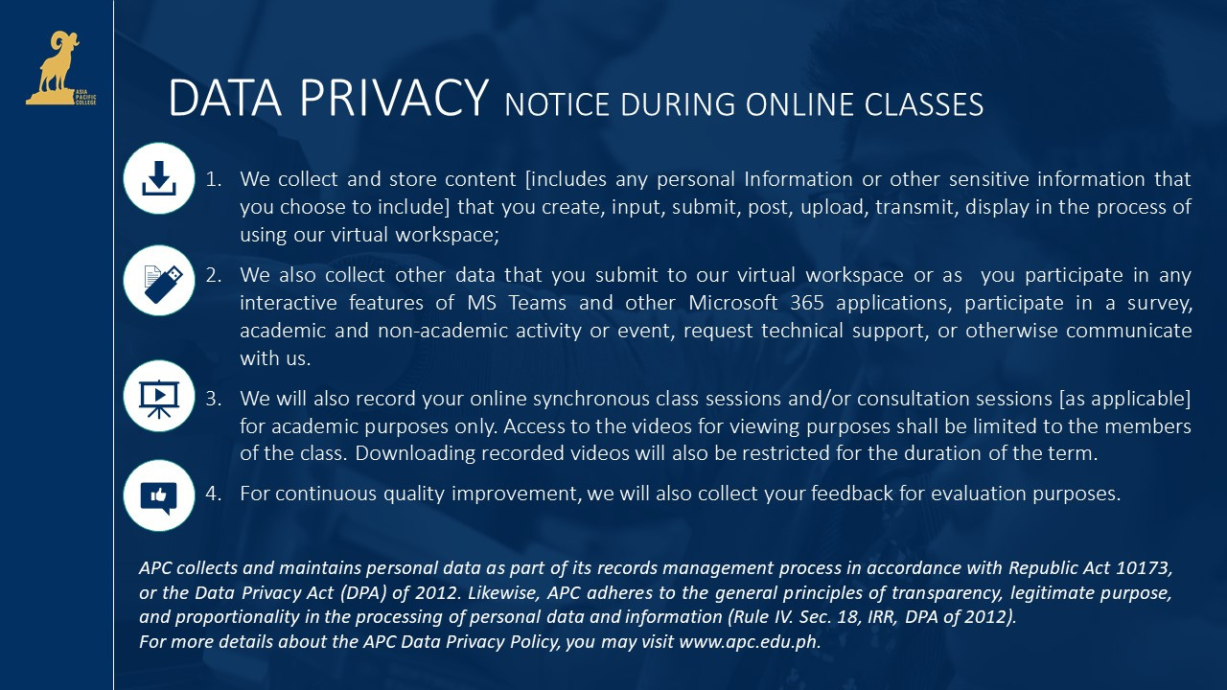

Notes:
Good Afternoon everyone! Our team nameless consisting of Jay Pardines, Julian Mistica, Klarenz Jasme, and Noel Francisco will be presenting our project titled

Slide 2
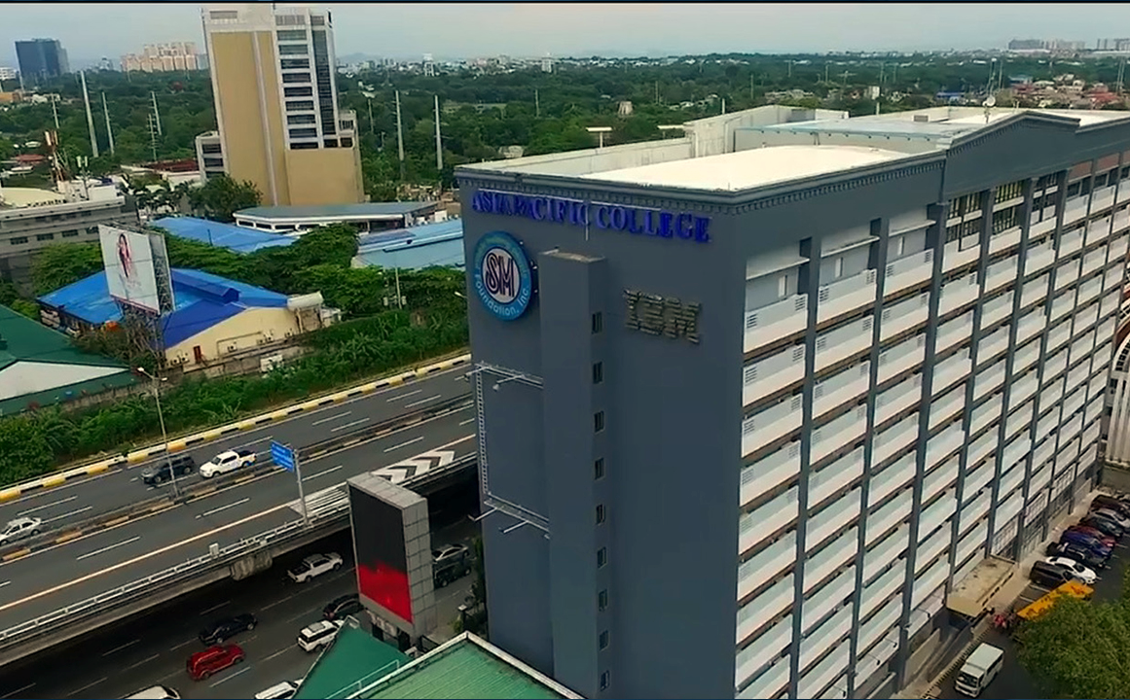

Queensway Website
Team MMD2K
Ashly Jude Degala ​
John Rex Merencillo​
Julian Sebastian Mistica​
Kurt Yuri Fegarido​
Kurt Saquillo​
Notes:
Data Protection Model: Enhancing Security Measures for Personal and Sensitive Information of Health Care Records in Telehealth.

Slide 3
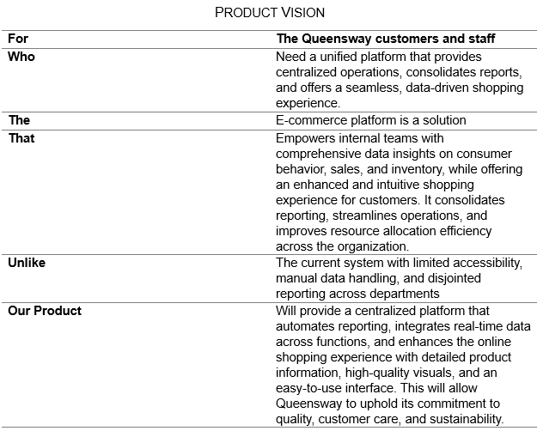
ASIA PACIFIC COLLEGE ASIA PACIFIC COLLEGE ASIA PACIFIC COLLEGE ASIA PACIFIC COLLEGE NOT FOR SALE ASIA PACIFIC COLLEGE ASIA PACIFIC COLLEGE ASIA PACIFIC COLLEGE ASIA PACIFIC COLLEGE ASIA PACIFIC COLLEGE NOT FOR SALE ASIA PACIFIC COLLEGE ASIA PACIFIC COLLEGE ASIA PACIFIC COLLEGE ASIA PACIFIC COLLEGE ASIA PACIFIC COLLEGE ASIA PACIFIC COLLEGE NOT FOR SALE ASIA PACIFIC COLLEGE ASIA PACIFIC COLLEGE ASIA PACIFIC COLLEGE ASIA PACIFIC COLLEGE ASIA PACIFIC COLLEGE NOT FOR SALE ASIA PACIFIC COLLEGE ASIA PACIFIC COLLEGE ASIA PACIFIC COLLEGE ASIA PACIFIC COLLEGE ASIA PACIFIC COLLEGE NOT FOR SALE ASIA PACIFIC COLLEGE ASIA PACIFIC
Product Vision
Notes:
Cryptographic failures remain one of the most pressing vulnerabilities in web application security today. Despite advances in technology, issues in cryptography are still ranked as the number two risk on the OWASP Top 10 list of web application security threats. These failures often lead to sensitive data exposure, posing significant risks to both users and organizations. This highlights the importance of implementing robust encryption methods and following best practices to protect against data breaches.
Now that we've seen how cryptographic failures are a major vulnerability, particularly with the potential for sensitive data exposure, let's look at our project's objectives to address this issue.

Slide 4
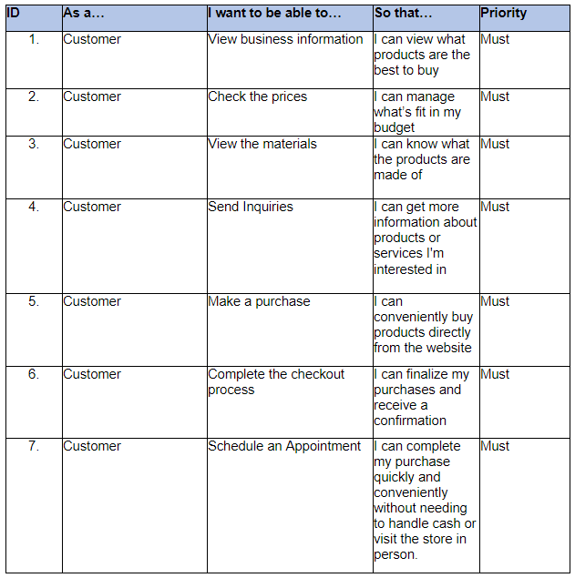
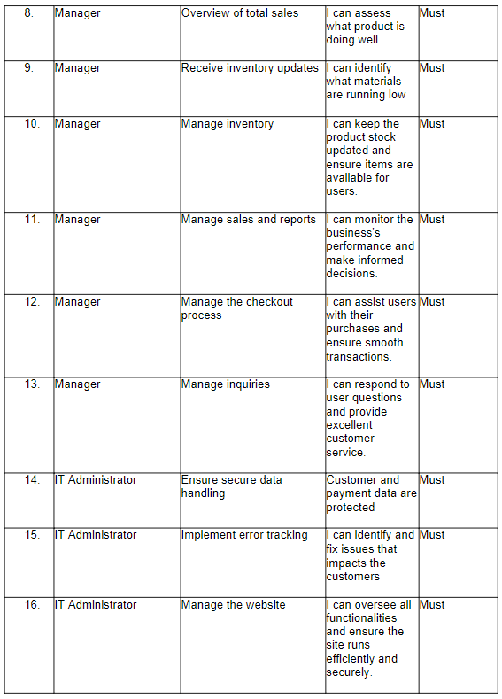
ASIA PACIFIC COLLEGE ASIA PACIFIC COLLEGE ASIA PACIFIC COLLEGE ASIA PACIFIC COLLEGE NOT FOR SALE ASIA PACIFIC COLLEGE ASIA PACIFIC COLLEGE ASIA PACIFIC COLLEGE ASIA PACIFIC COLLEGE ASIA PACIFIC COLLEGE NOT FOR SALE ASIA PACIFIC COLLEGE ASIA PACIFIC COLLEGE ASIA PACIFIC COLLEGE ASIA PACIFIC COLLEGE ASIA PACIFIC COLLEGE ASIA PACIFIC COLLEGE NOT FOR SALE ASIA PACIFIC COLLEGE ASIA PACIFIC COLLEGE ASIA PACIFIC COLLEGE ASIA PACIFIC COLLEGE ASIA PACIFIC COLLEGE NOT FOR SALE ASIA PACIFIC COLLEGE ASIA PACIFIC COLLEGE ASIA PACIFIC COLLEGE ASIA PACIFIC COLLEGE ASIA PACIFIC COLLEGE NOT FOR SALE ASIA PACIFIC COLLEGE ASIA PACIFIC
Product Backlogs / User Stories
Notes:
Cryptographic failures remain one of the most pressing vulnerabilities in web application security today. Despite advances in technology, issues in cryptography are still ranked as the number two risk on the OWASP Top 10 list of web application security threats. These failures often lead to sensitive data exposure, posing significant risks to both users and organizations. This highlights the importance of implementing robust encryption methods and following best practices to protect against data breaches.
Now that we've seen how cryptographic failures are a major vulnerability, particularly with the potential for sensitive data exposure, let's look at our project's objectives to address this issue.

Slide 5
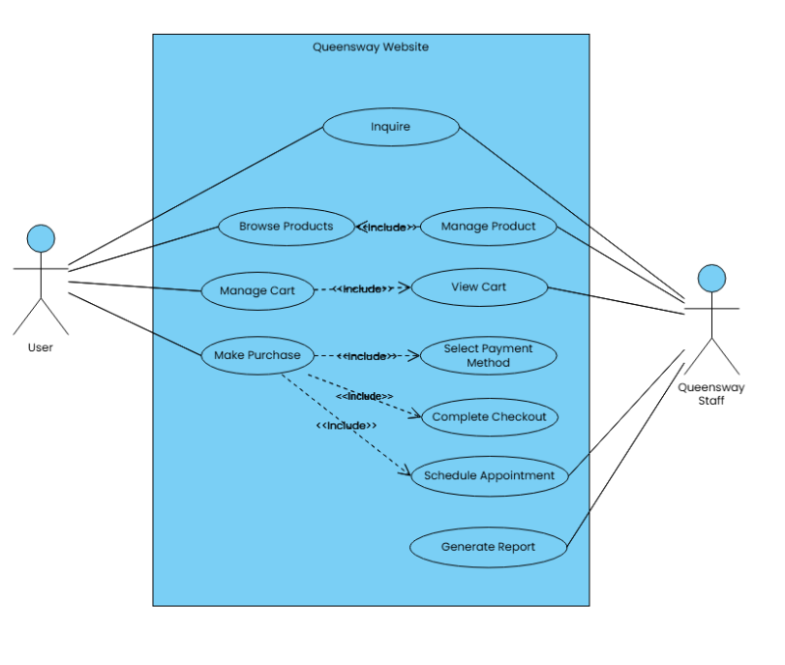
ASIA PACIFIC COLLEGE ASIA PACIFIC COLLEGE ASIA PACIFIC COLLEGE ASIA PACIFIC COLLEGE NOT FOR SALE ASIA PACIFIC COLLEGE ASIA PACIFIC COLLEGE ASIA PACIFIC COLLEGE ASIA PACIFIC COLLEGE ASIA PACIFIC COLLEGE NOT FOR SALE ASIA PACIFIC COLLEGE ASIA PACIFIC COLLEGE ASIA PACIFIC COLLEGE ASIA PACIFIC COLLEGE ASIA PACIFIC COLLEGE ASIA PACIFIC COLLEGE NOT FOR SALE ASIA PACIFIC COLLEGE ASIA PACIFIC COLLEGE ASIA PACIFIC COLLEGE ASIA PACIFIC COLLEGE ASIA PACIFIC COLLEGE NOT FOR SALE ASIA PACIFIC COLLEGE ASIA PACIFIC COLLEGE ASIA PACIFIC COLLEGE ASIA PACIFIC COLLEGE ASIA PACIFIC COLLEGE NOT FOR SALE ASIA PACIFIC COLLEGE ASIA PACIFIC
Use Case Diagram
Notes:
Cryptographic failures remain one of the most pressing vulnerabilities in web application security today. Despite advances in technology, issues in cryptography are still ranked as the number two risk on the OWASP Top 10 list of web application security threats. These failures often lead to sensitive data exposure, posing significant risks to both users and organizations. This highlights the importance of implementing robust encryption methods and following best practices to protect against data breaches.
Now that we've seen how cryptographic failures are a major vulnerability, particularly with the potential for sensitive data exposure, let's look at our project's objectives to address this issue.

Slide 6
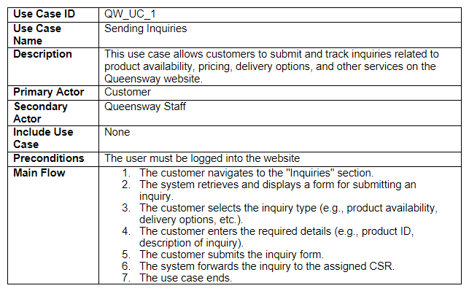
ASIA PACIFIC COLLEGE ASIA PACIFIC COLLEGE ASIA PACIFIC COLLEGE ASIA PACIFIC COLLEGE NOT FOR SALE ASIA PACIFIC COLLEGE ASIA PACIFIC COLLEGE ASIA PACIFIC COLLEGE ASIA PACIFIC COLLEGE ASIA PACIFIC COLLEGE NOT FOR SALE ASIA PACIFIC COLLEGE ASIA PACIFIC COLLEGE ASIA PACIFIC COLLEGE ASIA PACIFIC COLLEGE ASIA PACIFIC COLLEGE ASIA PACIFIC COLLEGE NOT FOR SALE ASIA PACIFIC COLLEGE ASIA PACIFIC COLLEGE ASIA PACIFIC COLLEGE ASIA PACIFIC COLLEGE ASIA PACIFIC COLLEGE NOT FOR SALE ASIA PACIFIC COLLEGE ASIA PACIFIC COLLEGE ASIA PACIFIC COLLEGE ASIA PACIFIC COLLEGE ASIA PACIFIC COLLEGE NOT FOR SALE ASIA PACIFIC COLLEGE ASIA PACIFIC
Use Case Full Description
Notes:
Cryptographic failures remain one of the most pressing vulnerabilities in web application security today. Despite advances in technology, issues in cryptography are still ranked as the number two risk on the OWASP Top 10 list of web application security threats. These failures often lead to sensitive data exposure, posing significant risks to both users and organizations. This highlights the importance of implementing robust encryption methods and following best practices to protect against data breaches.
Now that we've seen how cryptographic failures are a major vulnerability, particularly with the potential for sensitive data exposure, let's look at our project's objectives to address this issue.

Slide 7
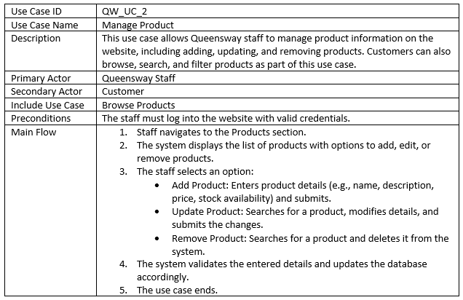
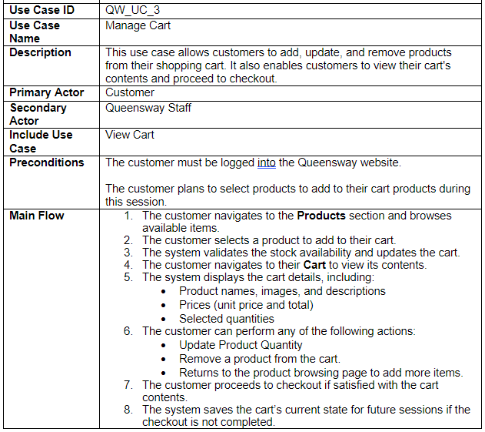
ASIA PACIFIC COLLEGE ASIA PACIFIC COLLEGE ASIA PACIFIC COLLEGE ASIA PACIFIC COLLEGE NOT FOR SALE ASIA PACIFIC COLLEGE ASIA PACIFIC COLLEGE ASIA PACIFIC COLLEGE ASIA PACIFIC COLLEGE ASIA PACIFIC COLLEGE NOT FOR SALE ASIA PACIFIC COLLEGE ASIA PACIFIC COLLEGE ASIA PACIFIC COLLEGE ASIA PACIFIC COLLEGE ASIA PACIFIC COLLEGE ASIA PACIFIC COLLEGE NOT FOR SALE ASIA PACIFIC COLLEGE ASIA PACIFIC COLLEGE ASIA PACIFIC COLLEGE ASIA PACIFIC COLLEGE ASIA PACIFIC COLLEGE NOT FOR SALE ASIA PACIFIC COLLEGE ASIA PACIFIC COLLEGE ASIA PACIFIC COLLEGE ASIA PACIFIC COLLEGE ASIA PACIFIC COLLEGE NOT FOR SALE ASIA PACIFIC COLLEGE ASIA PACIFIC
Use Case Full Description
Notes:
Cryptographic failures remain one of the most pressing vulnerabilities in web application security today. Despite advances in technology, issues in cryptography are still ranked as the number two risk on the OWASP Top 10 list of web application security threats. These failures often lead to sensitive data exposure, posing significant risks to both users and organizations. This highlights the importance of implementing robust encryption methods and following best practices to protect against data breaches.
Now that we've seen how cryptographic failures are a major vulnerability, particularly with the potential for sensitive data exposure, let's look at our project's objectives to address this issue.

Slide 8
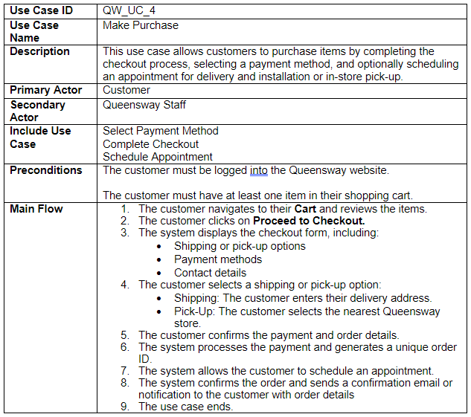
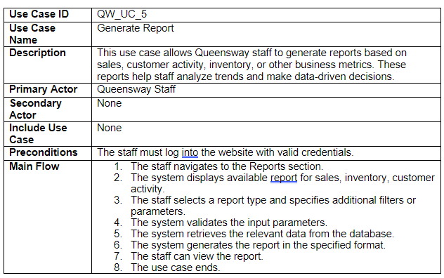
ASIA PACIFIC COLLEGE ASIA PACIFIC COLLEGE ASIA PACIFIC COLLEGE ASIA PACIFIC COLLEGE NOT FOR SALE ASIA PACIFIC COLLEGE ASIA PACIFIC COLLEGE ASIA PACIFIC COLLEGE ASIA PACIFIC COLLEGE ASIA PACIFIC COLLEGE NOT FOR SALE ASIA PACIFIC COLLEGE ASIA PACIFIC COLLEGE ASIA PACIFIC COLLEGE ASIA PACIFIC COLLEGE ASIA PACIFIC COLLEGE ASIA PACIFIC COLLEGE NOT FOR SALE ASIA PACIFIC COLLEGE ASIA PACIFIC COLLEGE ASIA PACIFIC COLLEGE ASIA PACIFIC COLLEGE ASIA PACIFIC COLLEGE NOT FOR SALE ASIA PACIFIC COLLEGE ASIA PACIFIC COLLEGE ASIA PACIFIC COLLEGE ASIA PACIFIC COLLEGE ASIA PACIFIC COLLEGE NOT FOR SALE ASIA PACIFIC COLLEGE ASIA PACIFIC
Use Case Full Description
Notes:
Cryptographic failures remain one of the most pressing vulnerabilities in web application security today. Despite advances in technology, issues in cryptography are still ranked as the number two risk on the OWASP Top 10 list of web application security threats. These failures often lead to sensitive data exposure, posing significant risks to both users and organizations. This highlights the importance of implementing robust encryption methods and following best practices to protect against data breaches.
Now that we've seen how cryptographic failures are a major vulnerability, particularly with the potential for sensitive data exposure, let's look at our project's objectives to address this issue.

Slide 9
ASIA PACIFIC COLLEGE ASIA PACIFIC COLLEGE ASIA PACIFIC COLLEGE ASIA PACIFIC COLLEGE NOT FOR SALE ASIA PACIFIC COLLEGE ASIA PACIFIC COLLEGE ASIA PACIFIC COLLEGE ASIA PACIFIC COLLEGE ASIA PACIFIC COLLEGE NOT FOR SALE ASIA PACIFIC COLLEGE ASIA PACIFIC COLLEGE ASIA PACIFIC COLLEGE ASIA PACIFIC COLLEGE ASIA PACIFIC COLLEGE ASIA PACIFIC COLLEGE NOT FOR SALE ASIA PACIFIC COLLEGE ASIA PACIFIC COLLEGE ASIA PACIFIC COLLEGE ASIA PACIFIC COLLEGE ASIA PACIFIC COLLEGE NOT FOR SALE ASIA PACIFIC COLLEGE ASIA PACIFIC COLLEGE ASIA PACIFIC COLLEGE ASIA PACIFIC COLLEGE ASIA PACIFIC COLLEGE NOT FOR SALE ASIA PACIFIC COLLEGE ASIA PACIFIC
Use Case Full Description
Notes:
Cryptographic failures remain one of the most pressing vulnerabilities in web application security today. Despite advances in technology, issues in cryptography are still ranked as the number two risk on the OWASP Top 10 list of web application security threats. These failures often lead to sensitive data exposure, posing significant risks to both users and organizations. This highlights the importance of implementing robust encryption methods and following best practices to protect against data breaches.
Now that we've seen how cryptographic failures are a major vulnerability, particularly with the potential for sensitive data exposure, let's look at our project's objectives to address this issue.

Slide 10
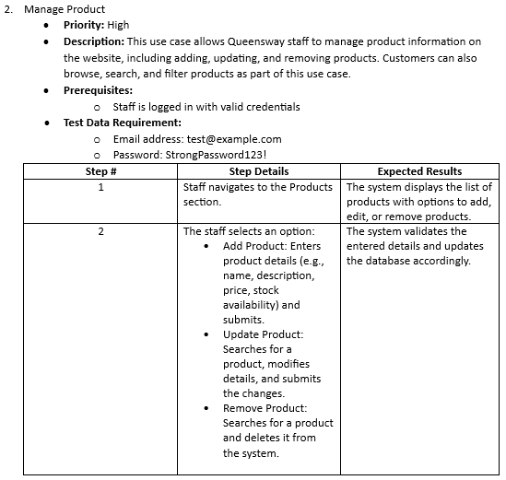
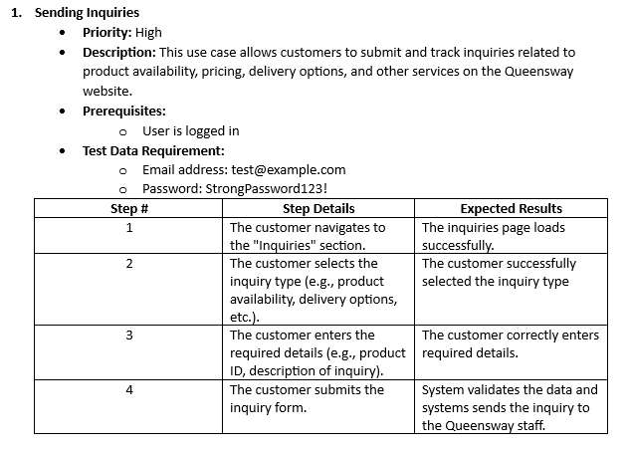
ASIA PACIFIC COLLEGE ASIA PACIFIC COLLEGE ASIA PACIFIC COLLEGE ASIA PACIFIC COLLEGE NOT FOR SALE ASIA PACIFIC COLLEGE ASIA PACIFIC COLLEGE ASIA PACIFIC COLLEGE ASIA PACIFIC COLLEGE ASIA PACIFIC COLLEGE NOT FOR SALE ASIA PACIFIC COLLEGE ASIA PACIFIC COLLEGE ASIA PACIFIC COLLEGE ASIA PACIFIC COLLEGE ASIA PACIFIC COLLEGE ASIA PACIFIC COLLEGE NOT FOR SALE ASIA PACIFIC COLLEGE ASIA PACIFIC COLLEGE ASIA PACIFIC COLLEGE ASIA PACIFIC COLLEGE ASIA PACIFIC COLLEGE NOT FOR SALE ASIA PACIFIC COLLEGE ASIA PACIFIC COLLEGE ASIA PACIFIC COLLEGE ASIA PACIFIC COLLEGE ASIA PACIFIC COLLEGE NOT FOR SALE ASIA PACIFIC COLLEGE ASIA PACIFIC
Test Case
Notes:
Cryptographic failures remain one of the most pressing vulnerabilities in web application security today. Despite advances in technology, issues in cryptography are still ranked as the number two risk on the OWASP Top 10 list of web application security threats. These failures often lead to sensitive data exposure, posing significant risks to both users and organizations. This highlights the importance of implementing robust encryption methods and following best practices to protect against data breaches.
Now that we've seen how cryptographic failures are a major vulnerability, particularly with the potential for sensitive data exposure, let's look at our project's objectives to address this issue.

Slide 11
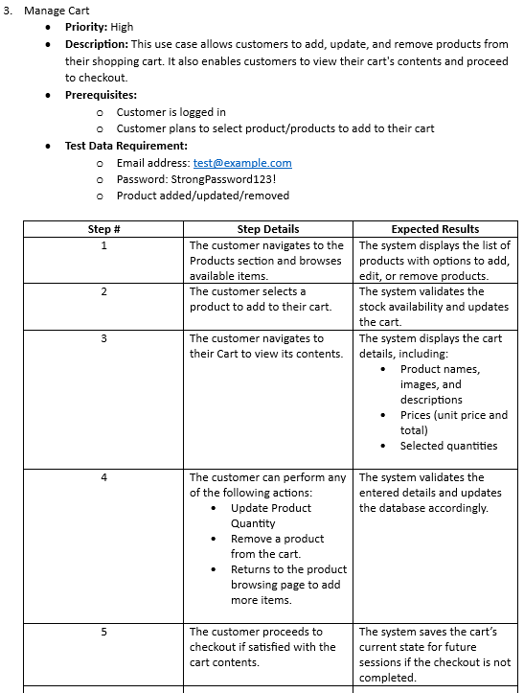
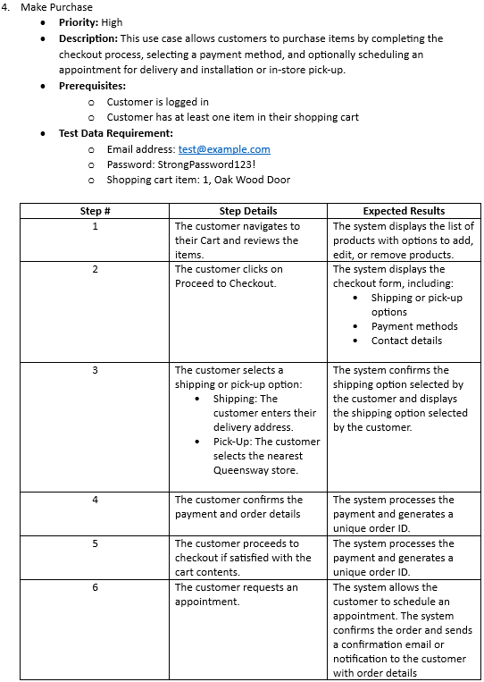
ASIA PACIFIC COLLEGE ASIA PACIFIC COLLEGE ASIA PACIFIC COLLEGE ASIA PACIFIC COLLEGE NOT FOR SALE ASIA PACIFIC COLLEGE ASIA PACIFIC COLLEGE ASIA PACIFIC COLLEGE ASIA PACIFIC COLLEGE ASIA PACIFIC COLLEGE NOT FOR SALE ASIA PACIFIC COLLEGE ASIA PACIFIC COLLEGE ASIA PACIFIC COLLEGE ASIA PACIFIC COLLEGE ASIA PACIFIC COLLEGE ASIA PACIFIC COLLEGE NOT FOR SALE ASIA PACIFIC COLLEGE ASIA PACIFIC COLLEGE ASIA PACIFIC COLLEGE ASIA PACIFIC COLLEGE ASIA PACIFIC COLLEGE NOT FOR SALE ASIA PACIFIC COLLEGE ASIA PACIFIC COLLEGE ASIA PACIFIC COLLEGE ASIA PACIFIC COLLEGE ASIA PACIFIC COLLEGE NOT FOR SALE ASIA PACIFIC COLLEGE ASIA PACIFIC
Notes:
Cryptographic failures remain one of the most pressing vulnerabilities in web application security today. Despite advances in technology, issues in cryptography are still ranked as the number two risk on the OWASP Top 10 list of web application security threats. These failures often lead to sensitive data exposure, posing significant risks to both users and organizations. This highlights the importance of implementing robust encryption methods and following best practices to protect against data breaches.
Now that we've seen how cryptographic failures are a major vulnerability, particularly with the potential for sensitive data exposure, let's look at our project's objectives to address this issue.

Slide 12
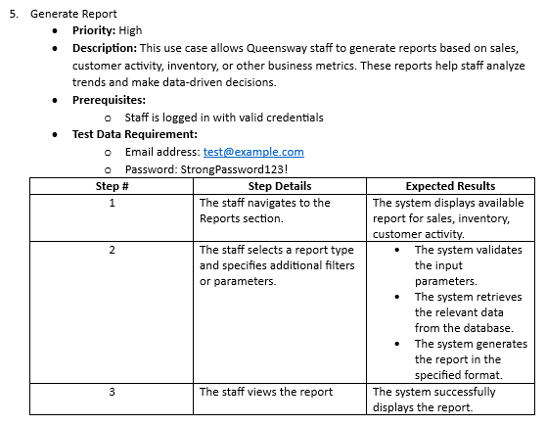
ASIA PACIFIC COLLEGE ASIA PACIFIC COLLEGE ASIA PACIFIC COLLEGE ASIA PACIFIC COLLEGE NOT FOR SALE ASIA PACIFIC COLLEGE ASIA PACIFIC COLLEGE ASIA PACIFIC COLLEGE ASIA PACIFIC COLLEGE ASIA PACIFIC COLLEGE NOT FOR SALE ASIA PACIFIC COLLEGE ASIA PACIFIC COLLEGE ASIA PACIFIC COLLEGE ASIA PACIFIC COLLEGE ASIA PACIFIC COLLEGE ASIA PACIFIC COLLEGE NOT FOR SALE ASIA PACIFIC COLLEGE ASIA PACIFIC COLLEGE ASIA PACIFIC COLLEGE ASIA PACIFIC COLLEGE ASIA PACIFIC COLLEGE NOT FOR SALE ASIA PACIFIC COLLEGE ASIA PACIFIC COLLEGE ASIA PACIFIC COLLEGE ASIA PACIFIC COLLEGE ASIA PACIFIC COLLEGE NOT FOR SALE ASIA PACIFIC COLLEGE ASIA PACIFIC
Notes:
Cryptographic failures remain one of the most pressing vulnerabilities in web application security today. Despite advances in technology, issues in cryptography are still ranked as the number two risk on the OWASP Top 10 list of web application security threats. These failures often lead to sensitive data exposure, posing significant risks to both users and organizations. This highlights the importance of implementing robust encryption methods and following best practices to protect against data breaches.
Now that we've seen how cryptographic failures are a major vulnerability, particularly with the potential for sensitive data exposure, let's look at our project's objectives to address this issue.

Slide 13
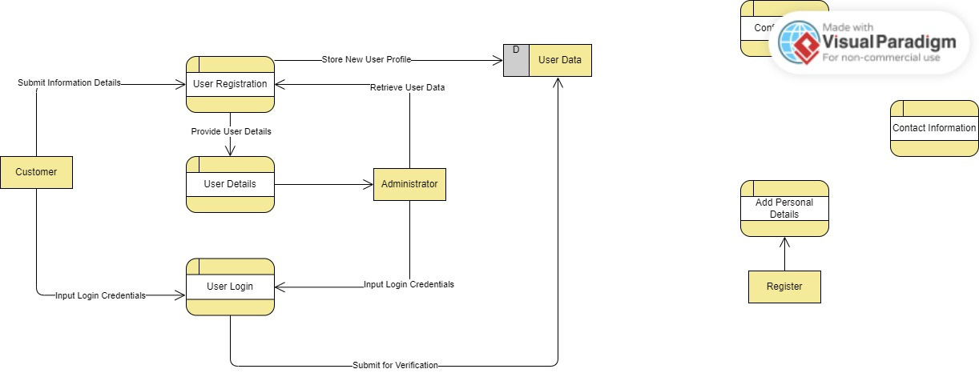
ASIA PACIFIC COLLEGE ASIA PACIFIC COLLEGE ASIA PACIFIC COLLEGE ASIA PACIFIC COLLEGE NOT FOR SALE ASIA PACIFIC COLLEGE ASIA PACIFIC COLLEGE ASIA PACIFIC COLLEGE ASIA PACIFIC COLLEGE ASIA PACIFIC COLLEGE NOT FOR SALE ASIA PACIFIC COLLEGE ASIA PACIFIC COLLEGE ASIA PACIFIC COLLEGE ASIA PACIFIC COLLEGE ASIA PACIFIC COLLEGE ASIA PACIFIC COLLEGE NOT FOR SALE ASIA PACIFIC COLLEGE ASIA PACIFIC COLLEGE ASIA PACIFIC COLLEGE ASIA PACIFIC COLLEGE ASIA PACIFIC COLLEGE NOT FOR SALE ASIA PACIFIC COLLEGE ASIA PACIFIC COLLEGE ASIA PACIFIC COLLEGE ASIA PACIFIC COLLEGE ASIA PACIFIC COLLEGE NOT FOR SALE ASIA PACIFIC COLLEGE ASIA PACIFIC
Data Flow Diagram Level 2
Notes:
Cryptographic failures remain one of the most pressing vulnerabilities in web application security today. Despite advances in technology, issues in cryptography are still ranked as the number two risk on the OWASP Top 10 list of web application security threats. These failures often lead to sensitive data exposure, posing significant risks to both users and organizations. This highlights the importance of implementing robust encryption methods and following best practices to protect against data breaches.
Now that we've seen how cryptographic failures are a major vulnerability, particularly with the potential for sensitive data exposure, let's look at our project's objectives to address this issue.

Slide 14
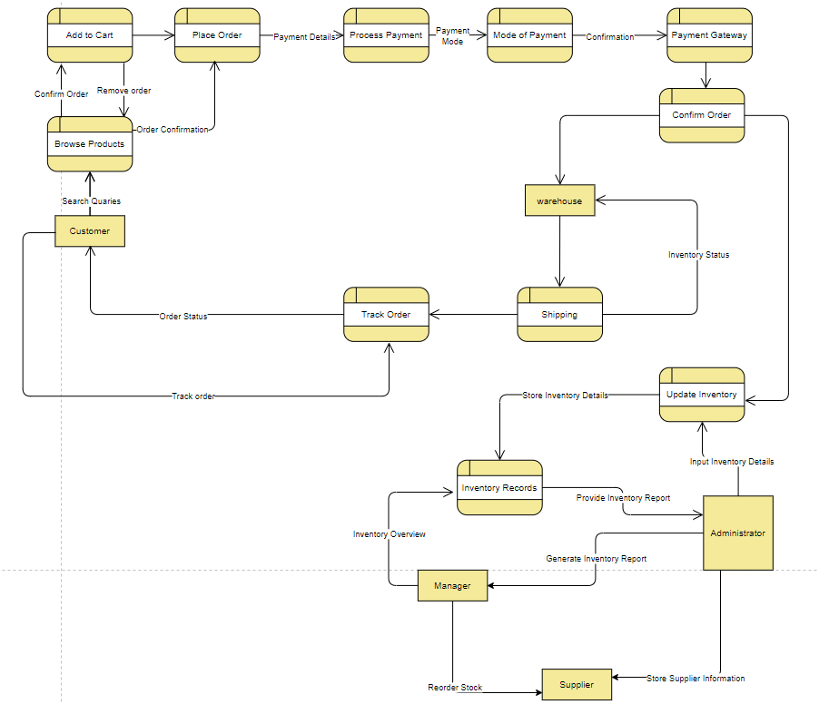
ASIA PACIFIC COLLEGE ASIA PACIFIC COLLEGE ASIA PACIFIC COLLEGE ASIA PACIFIC COLLEGE NOT FOR SALE ASIA PACIFIC COLLEGE ASIA PACIFIC COLLEGE ASIA PACIFIC COLLEGE ASIA PACIFIC COLLEGE ASIA PACIFIC COLLEGE NOT FOR SALE ASIA PACIFIC COLLEGE ASIA PACIFIC COLLEGE ASIA PACIFIC COLLEGE ASIA PACIFIC COLLEGE ASIA PACIFIC COLLEGE ASIA PACIFIC COLLEGE NOT FOR SALE ASIA PACIFIC COLLEGE ASIA PACIFIC COLLEGE ASIA PACIFIC COLLEGE ASIA PACIFIC COLLEGE ASIA PACIFIC COLLEGE NOT FOR SALE ASIA PACIFIC COLLEGE ASIA PACIFIC COLLEGE ASIA PACIFIC COLLEGE ASIA PACIFIC COLLEGE ASIA PACIFIC COLLEGE NOT FOR SALE ASIA PACIFIC COLLEGE ASIA PACIFIC
Data Flow Diagram Level 2
Notes:
Cryptographic failures remain one of the most pressing vulnerabilities in web application security today. Despite advances in technology, issues in cryptography are still ranked as the number two risk on the OWASP Top 10 list of web application security threats. These failures often lead to sensitive data exposure, posing significant risks to both users and organizations. This highlights the importance of implementing robust encryption methods and following best practices to protect against data breaches.
Now that we've seen how cryptographic failures are a major vulnerability, particularly with the potential for sensitive data exposure, let's look at our project's objectives to address this issue.

Slide 15
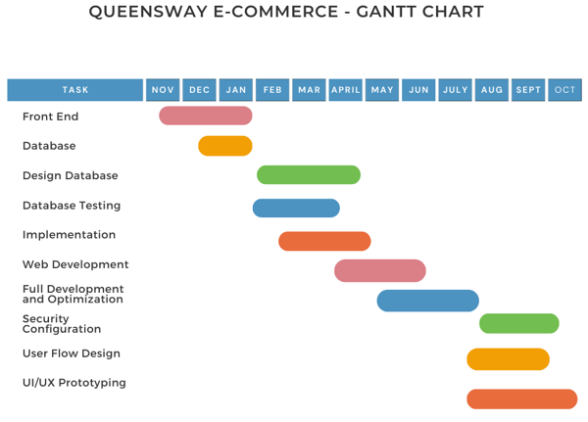
ASIA PACIFIC COLLEGE ASIA PACIFIC COLLEGE ASIA PACIFIC COLLEGE ASIA PACIFIC COLLEGE NOT FOR SALE ASIA PACIFIC COLLEGE ASIA PACIFIC COLLEGE ASIA PACIFIC COLLEGE ASIA PACIFIC COLLEGE ASIA PACIFIC COLLEGE NOT FOR SALE ASIA PACIFIC COLLEGE ASIA PACIFIC COLLEGE ASIA PACIFIC COLLEGE ASIA PACIFIC COLLEGE ASIA PACIFIC COLLEGE ASIA PACIFIC COLLEGE NOT FOR SALE ASIA PACIFIC COLLEGE ASIA PACIFIC COLLEGE ASIA PACIFIC COLLEGE ASIA PACIFIC COLLEGE ASIA PACIFIC COLLEGE NOT FOR SALE ASIA PACIFIC COLLEGE ASIA PACIFIC COLLEGE ASIA PACIFIC COLLEGE ASIA PACIFIC COLLEGE ASIA PACIFIC COLLEGE NOT FOR SALE ASIA PACIFIC COLLEGE ASIA PACIFIC
Project Schedule
Notes:
Cryptographic failures remain one of the most pressing vulnerabilities in web application security today. Despite advances in technology, issues in cryptography are still ranked as the number two risk on the OWASP Top 10 list of web application security threats. These failures often lead to sensitive data exposure, posing significant risks to both users and organizations. This highlights the importance of implementing robust encryption methods and following best practices to protect against data breaches.
Now that we've seen how cryptographic failures are a major vulnerability, particularly with the potential for sensitive data exposure, let's look at our project's objectives to address this issue.

Slide 16
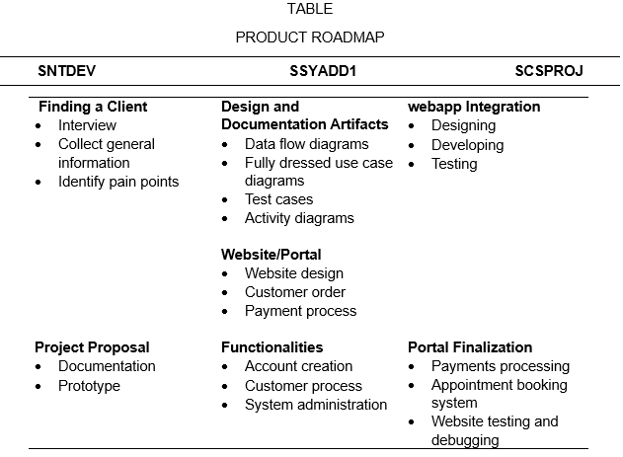
ASIA PACIFIC COLLEGE ASIA PACIFIC COLLEGE ASIA PACIFIC COLLEGE ASIA PACIFIC COLLEGE NOT FOR SALE ASIA PACIFIC COLLEGE ASIA PACIFIC COLLEGE ASIA PACIFIC COLLEGE ASIA PACIFIC COLLEGE ASIA PACIFIC COLLEGE NOT FOR SALE ASIA PACIFIC COLLEGE ASIA PACIFIC COLLEGE ASIA PACIFIC COLLEGE ASIA PACIFIC COLLEGE ASIA PACIFIC COLLEGE ASIA PACIFIC COLLEGE NOT FOR SALE ASIA PACIFIC COLLEGE ASIA PACIFIC COLLEGE ASIA PACIFIC COLLEGE ASIA PACIFIC COLLEGE ASIA PACIFIC COLLEGE NOT FOR SALE ASIA PACIFIC COLLEGE ASIA PACIFIC COLLEGE ASIA PACIFIC COLLEGE ASIA PACIFIC COLLEGE ASIA PACIFIC COLLEGE NOT FOR SALE ASIA PACIFIC COLLEGE ASIA PACIFIC
Product Roadmap
Notes:
Cryptographic failures remain one of the most pressing vulnerabilities in web application security today. Despite advances in technology, issues in cryptography are still ranked as the number two risk on the OWASP Top 10 list of web application security threats. These failures often lead to sensitive data exposure, posing significant risks to both users and organizations. This highlights the importance of implementing robust encryption methods and following best practices to protect against data breaches.
Now that we've seen how cryptographic failures are a major vulnerability, particularly with the potential for sensitive data exposure, let's look at our project's objectives to address this issue.

Slide 17
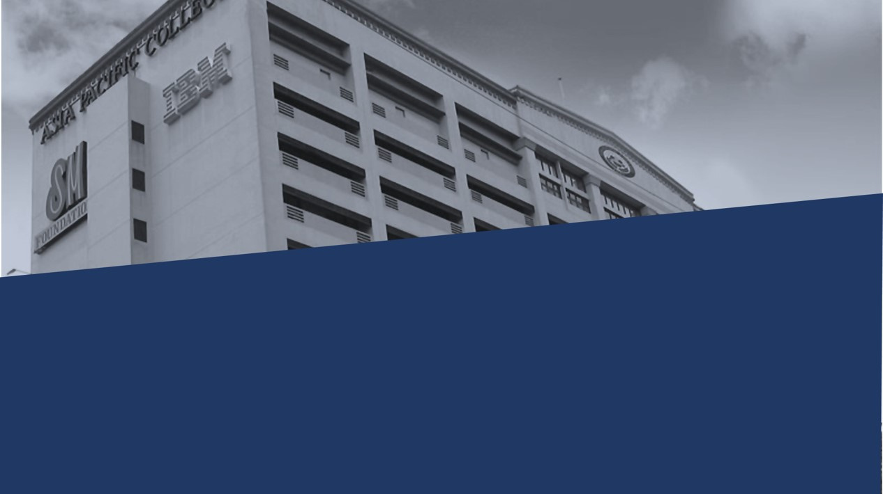


Thank You
Asia Pacific College
Real projects. Real learning

